Slide 1
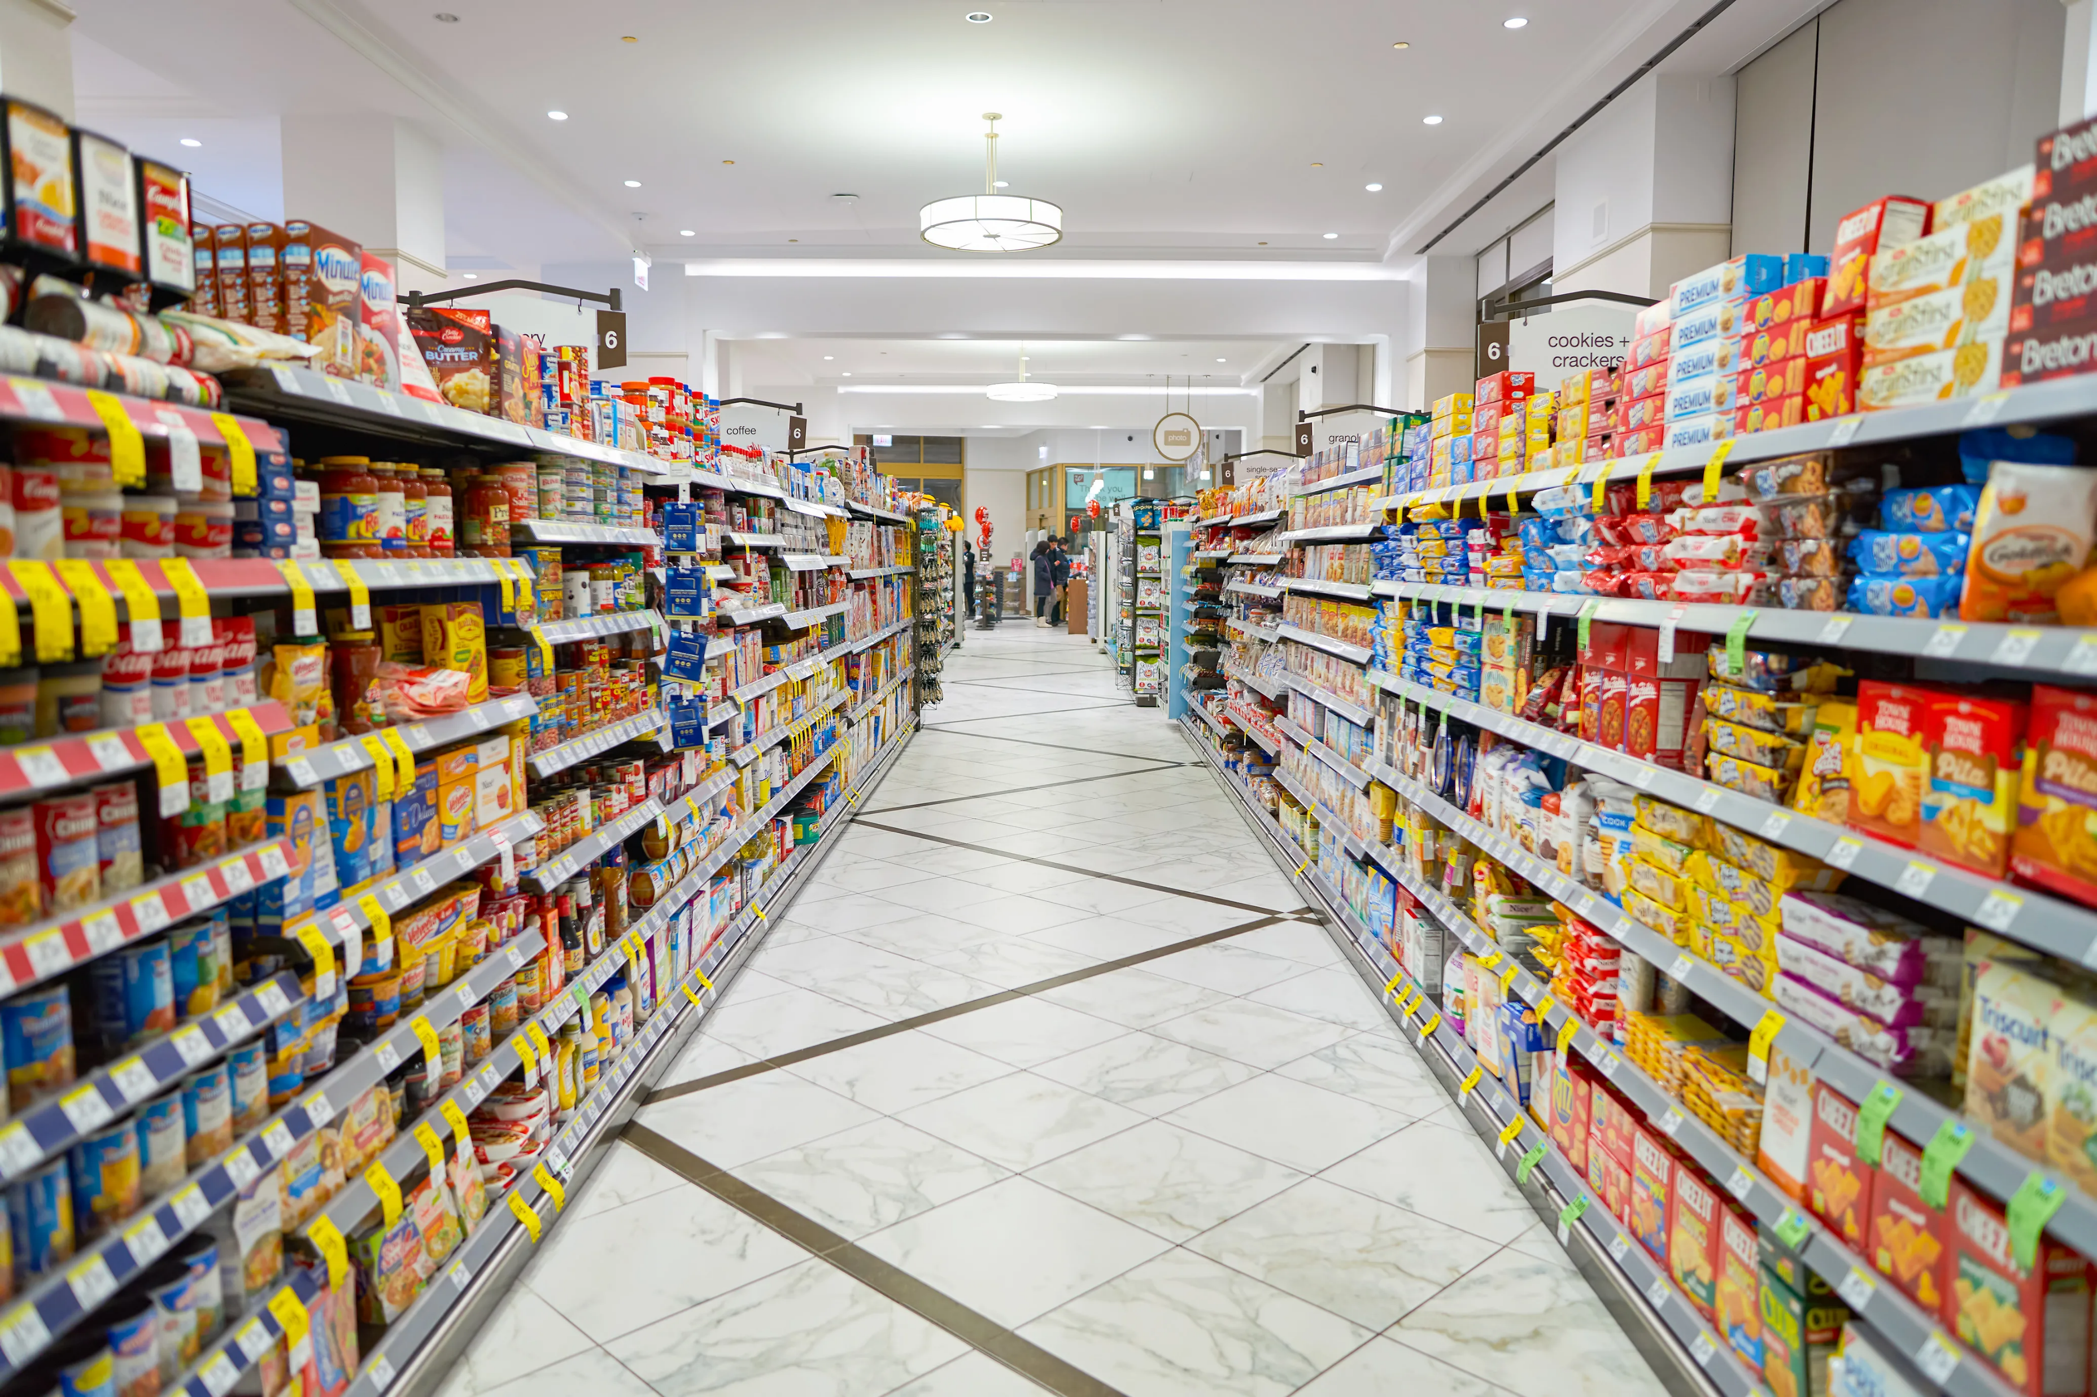
Data Analytics On Grocery Shopping

Slide 2
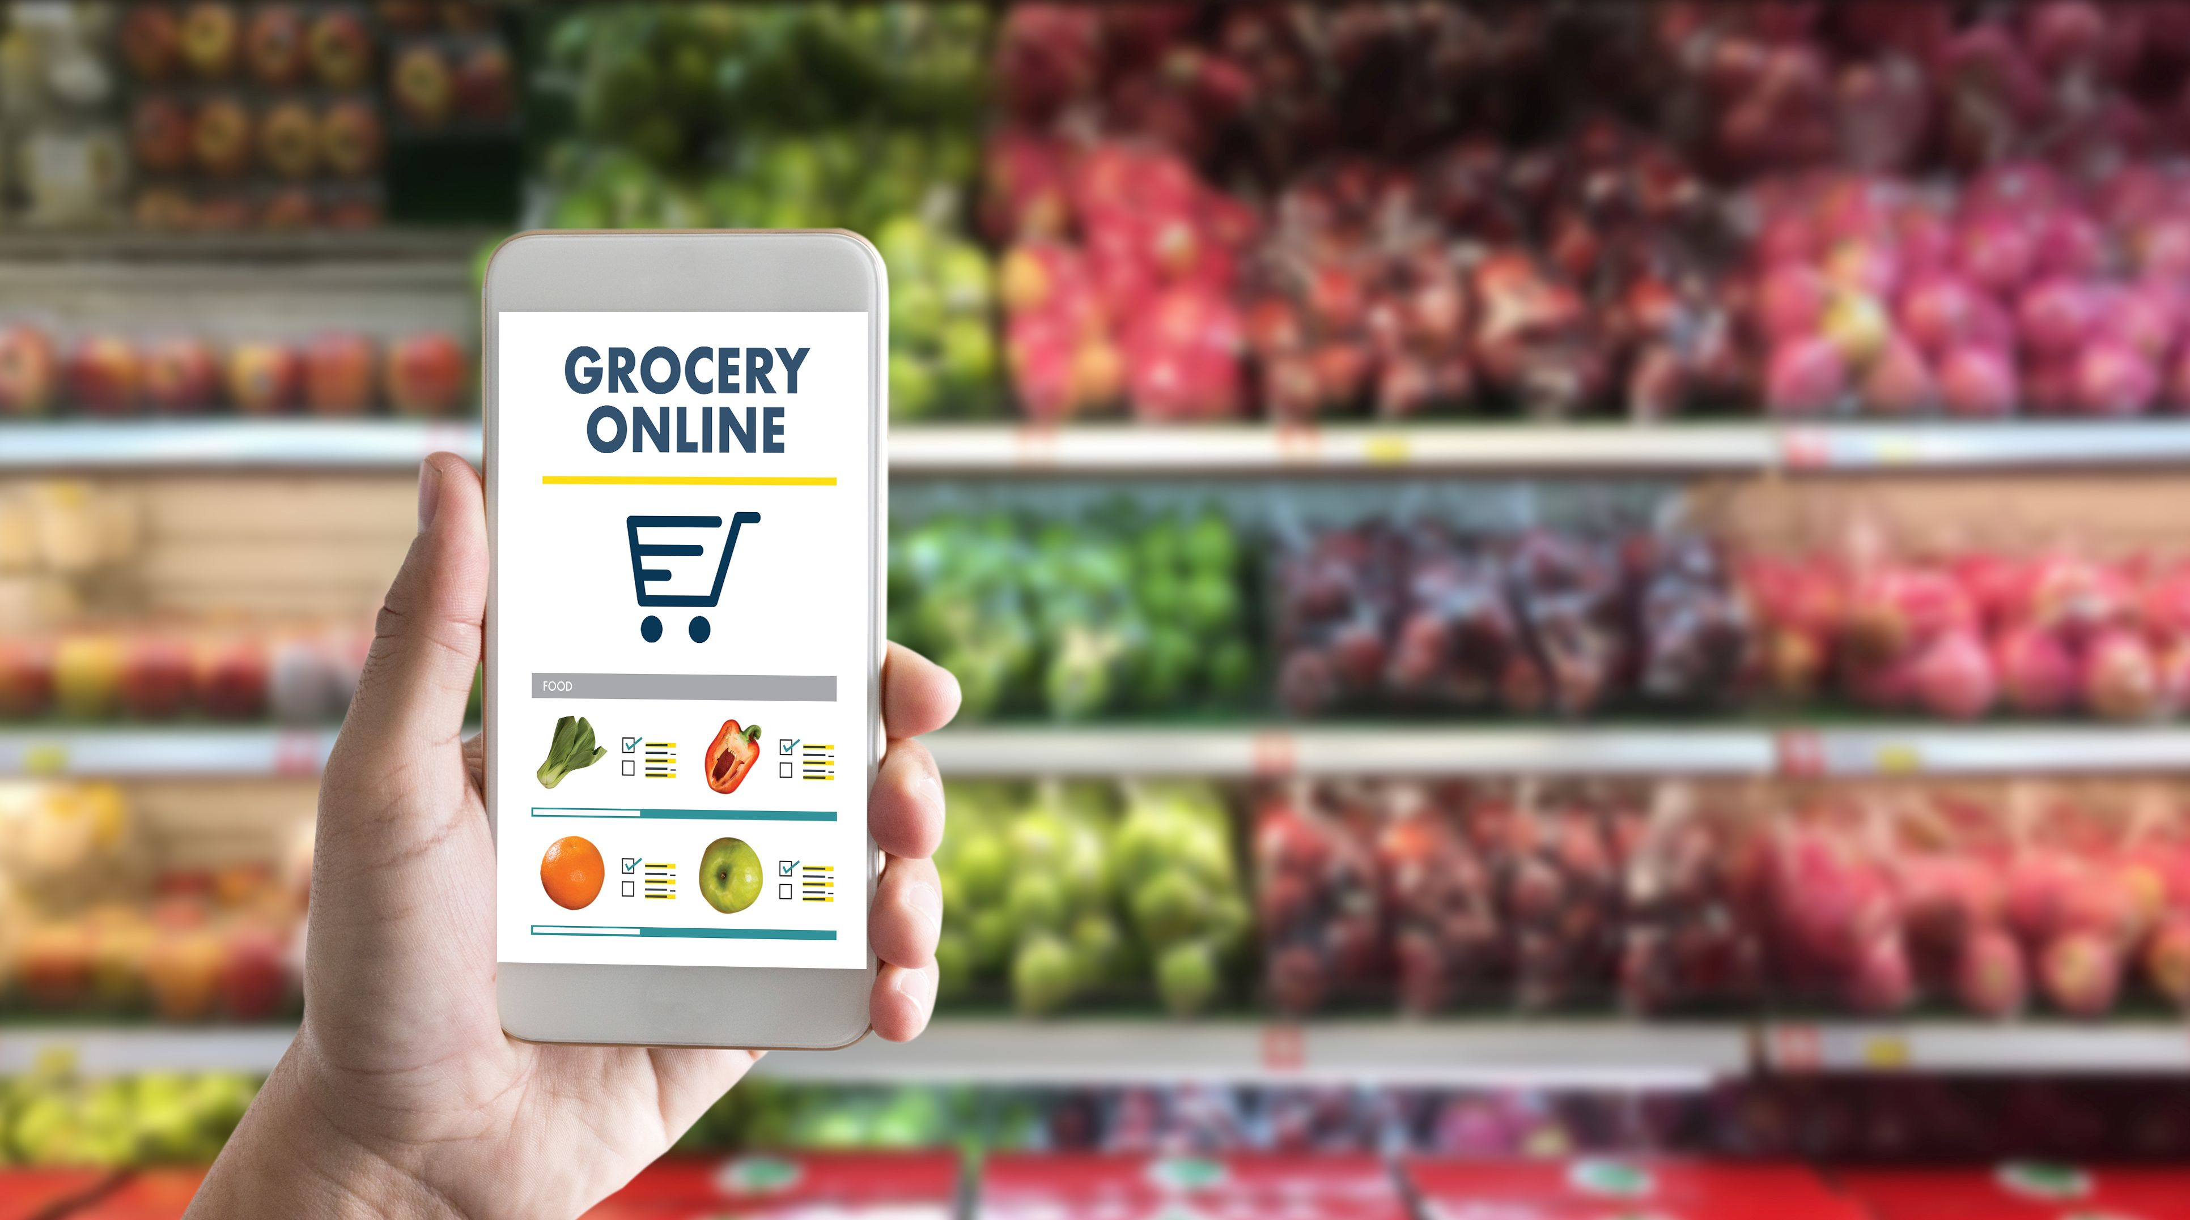
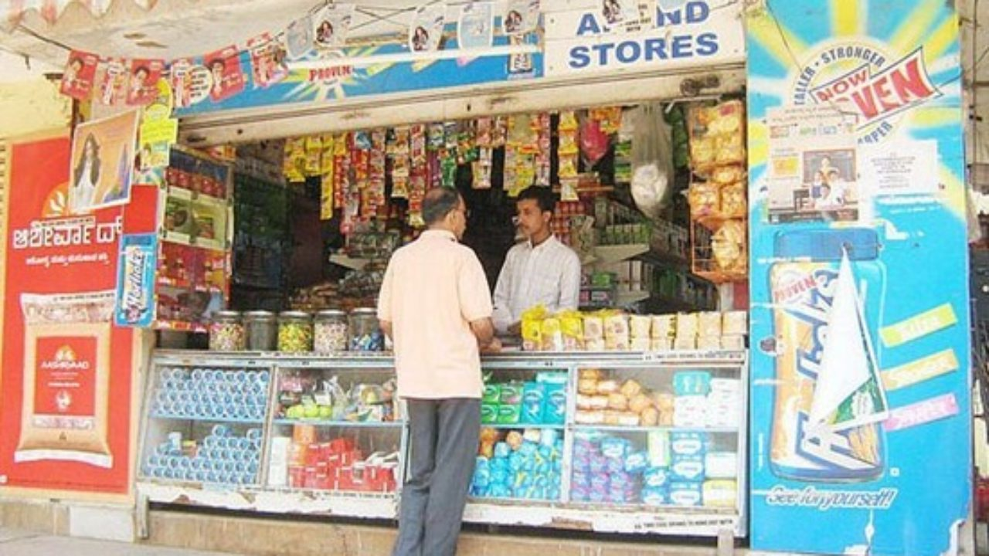
Plan
Online
Offline
Buying Groceries, the first thing comes into mind that what I can buy in groceries and that I need to decide before went to shop. So I will make a list of items to buy.
Now a days there are two platforms available where i can buy Groceries i.e. Offline(Small Shops, Big Bazar, DMart) & Online(Jiomart, Amazon, Flipkart, Danzo etc.)
But then based on discounts i will decide where i can buy those groceries. Whether it is Offline or Online, So that I can save money and can spend to buy on other things.

Slide 3
Prepare
Now i will compare the prices of Offline & Online stores most probably. So that i would get to know which platform is giving more discounts and less liability on Delivery or other charges.
Once i decided to go for shopping on the platform which gives more discounts then I will prepare for the budget of shopping, based on the list of items.
As if the items are more but not sufficient money you have to buy them.

Slide 4
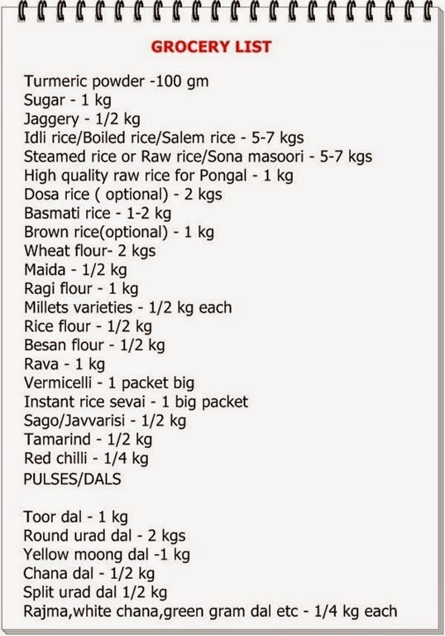
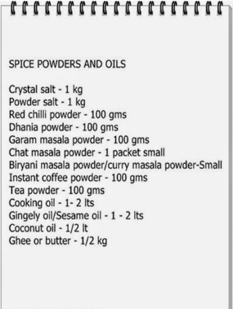
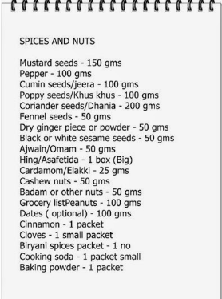
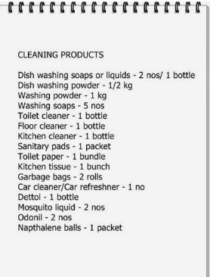
Process
Now I will have to prepare the Grocery list and the quantities of each product for 2 person as per the budget.

Slide 5
Analyze
When i visit the Grocery stores weather it is online or offline i observed the below things
I can see there are different types of companies who offers the same product with different prices.
That’s become bit toughest task to choose which is the best company among all those products. As I cant be sure about the quality of the product.
So then I will have to check the quantity as well as the content of the products, based on the quantities that i have to buy from the prepared list of items. Like if I am buying 5Kg sugar with 256 Rs, and the other company is giving me in less price i.e. in 245 Rs but the quantity they are offering me is 4.5Kg which has less 500Gms.
Also the date of expiration of the product. As sometimes you can see the product will expire in next month while the same product with same company, the expiration date is different. Because of the manufacturing date.

Slide 6
Share
Once I sort the products and the quantities as per the list of items that I have prepared, I will add them in my cart accordingly.
And will present them to the counter where I can pay the money and purchase.
Also I will enquire about the free products as well as discounts they offered on each items, depending on the platforms. Like if am purchasing groceries from Dmart, so they give the free items(offered on products) at the payment counter.
Act
Finally when the bill generated at the counter, I will check bill of each items if they are charged correctly, so that items that I am buying are not missed or added mistakenly.
Also will check the payment options as per my convenient mode of pay. like Debit Cart, Credit Card as well as UPI payments and pay accordingly.

